Slide 1
Build Enterprise Network ( 2 sites )
Team Members:
Instractor:
Mostafa Hesham Mostafa Mohamed Marwan Mohamed Youssef Fahmy Ahmed Abdelhakim
ENG. Wael Samir

Slide 2
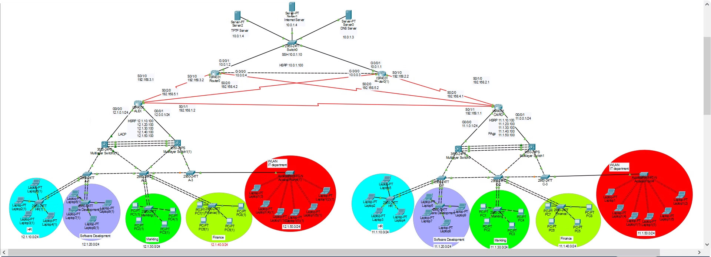
Project Photo

Slide 3

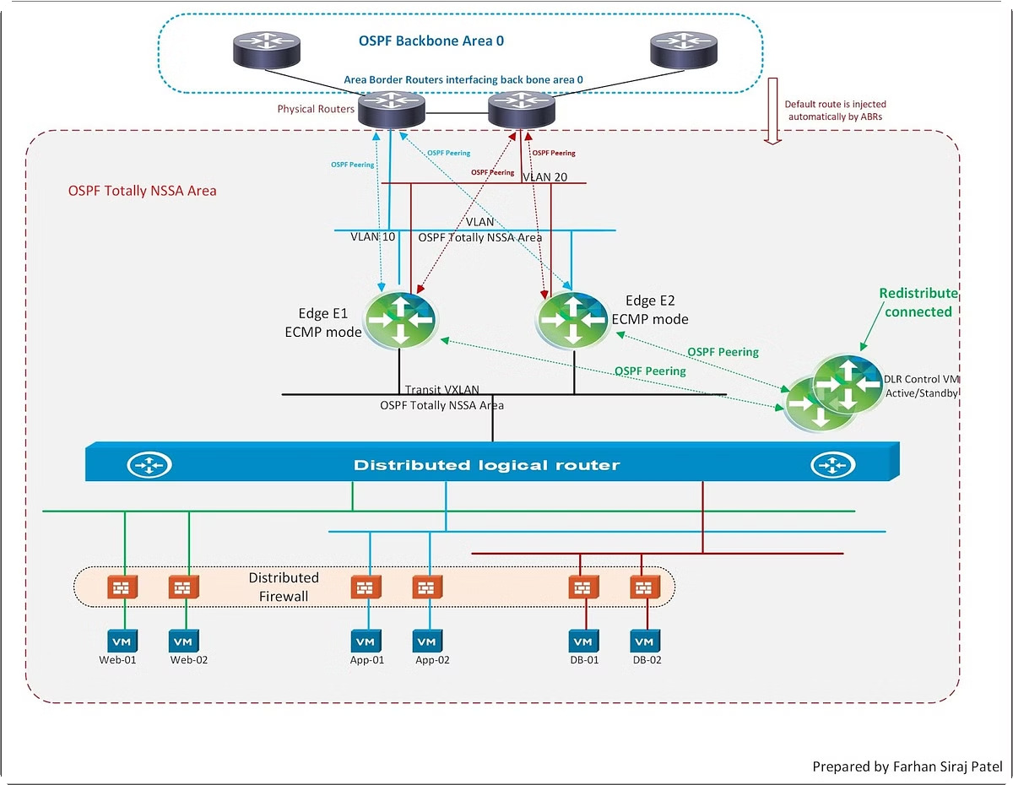
OSPF (Open Shortest Path First)
Link-State Protocol
OSPF builds a complete network map, allowing for efficient routing decisions based on the shortest path available.
Scalability
OSPF is suitable for large networks with many routers, handling complex routing scenarios without performance degradation.
Security
OSPF uses authentication mechanisms to prevent unauthorized configuration changes and secure the routing infrastructure.

Slide 4

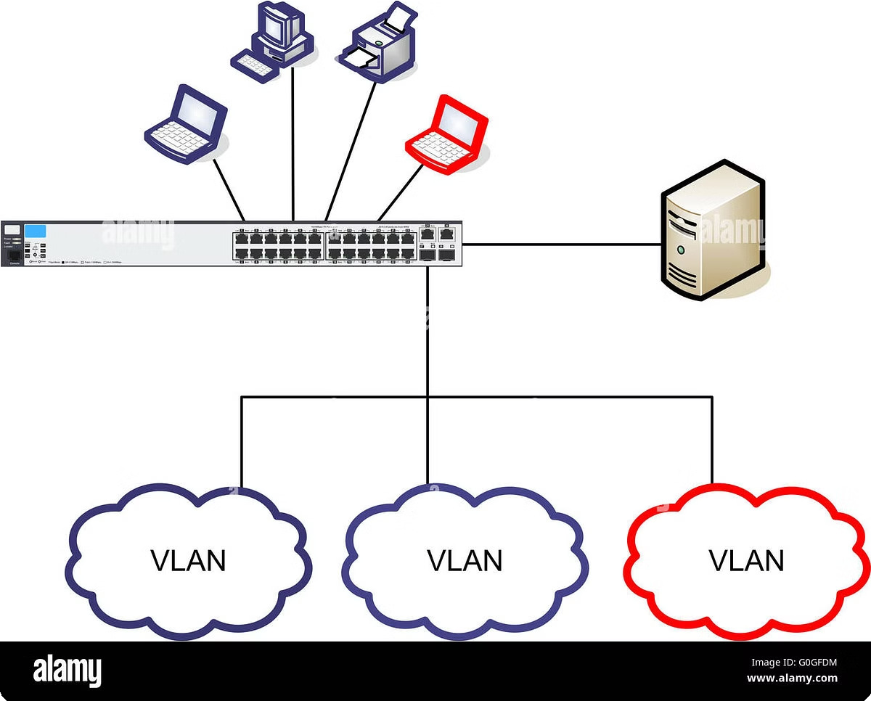
VLANS
1
Logical Segmentation
VLANS divide a network into logical segments, isolating traffic and enhancing security by limiting broadcast domains.
2
Improved Performance
VLANS reduce network congestion by segregating traffic, leading to improved performance for applications and services.
3
Flexibility
VLANS allow for dynamic network management, facilitating changes and updates without disrupting network operations.

Slide 5

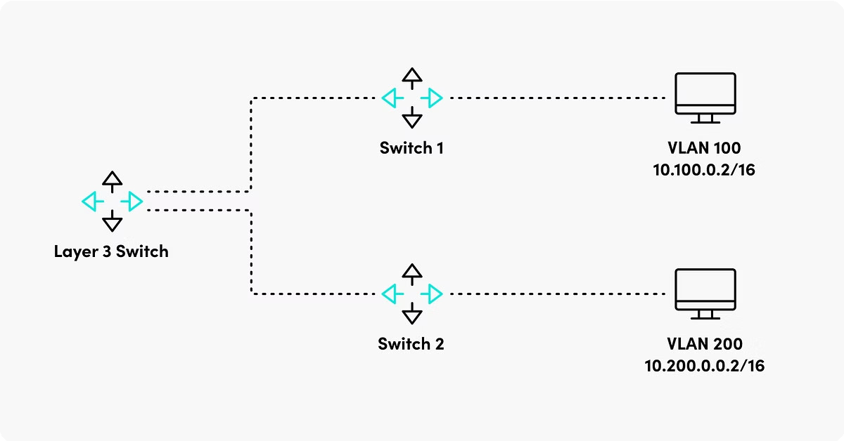
Inter-VLAN Routing
Router Interface
A router interface is configured to act as a gateway between different VLANs.
1
Routing Table
The router's routing table contains information about the network topology, allowing it to direct traffic between VLANs.
2
Data Transmission
Data packets are forwarded from one VLAN to another through the router, enabling communication across different segments.
3

Slide 6


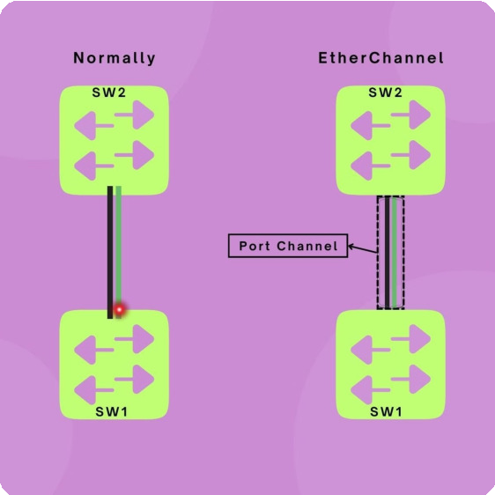
EtherChannel (PaGP/LACP)
Feature | PaGP | LACP
Standardization | Proprietary Cisco protocol | IEEE standard
Flexibility | Less flexible, limited to Cisco devices | More flexible, supports interoperability
 |  | with various vendors
Bandwidth Aggregation | Aggregates multiple physical links into a single logical channel, increasing | Aggregates multiple physical links into a single logical channel, increasing
 | bandwidth and redundancy. | bandwidth and redundancy.

Slide 7
HSRP (Hot Standby Router Protocol)
High Availability
HSRP provides redundancy, ensuring network connectivity even if a router fails, by having a backup router take over.
Virtual Router
HSRP creates a virtual router, a logical entity that represents the active router from the network's perspective.
Failover
If the active router fails, the backup router becomes active, maintaining network connectivity and minimizing downtime.

Slide 8


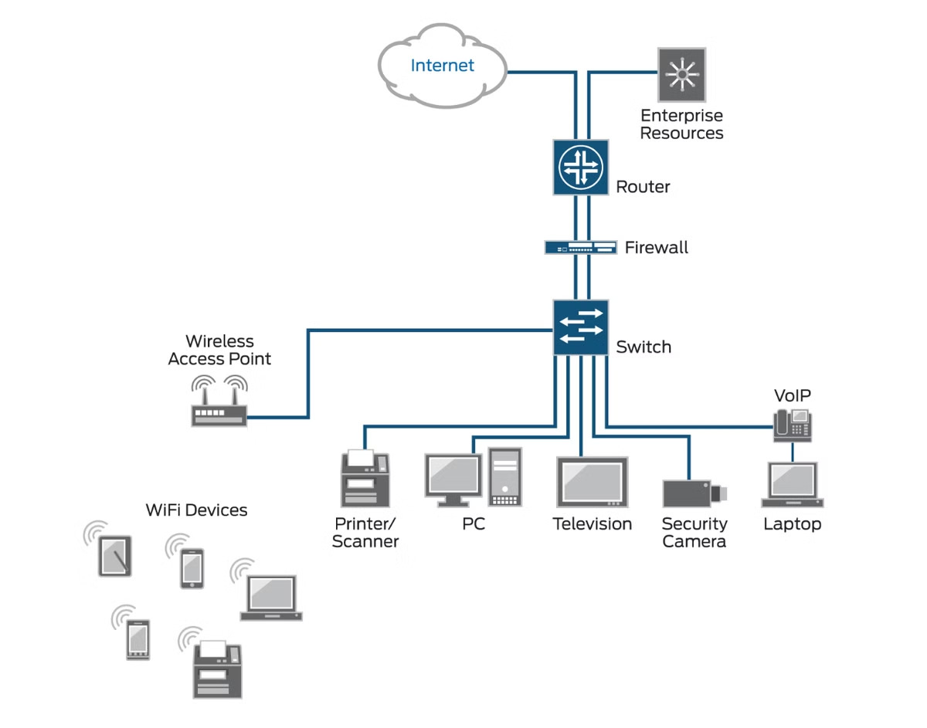
ACL (Access Control List)
1
Traffic Filtering
ACLs define rules to control network traffic, allowing or denying access based on various criteria, such as source IP address, destination port, or protocol.
2
Security Enhancement
ACLs strengthen network security by blocking malicious traffic and preventing unauthorized access to sensitive resources.
3
Network Management
ACLs provide a mechanism to manage network traffic flow, ensuring efficient utilization of resources and preventing congestion.

Slide 9


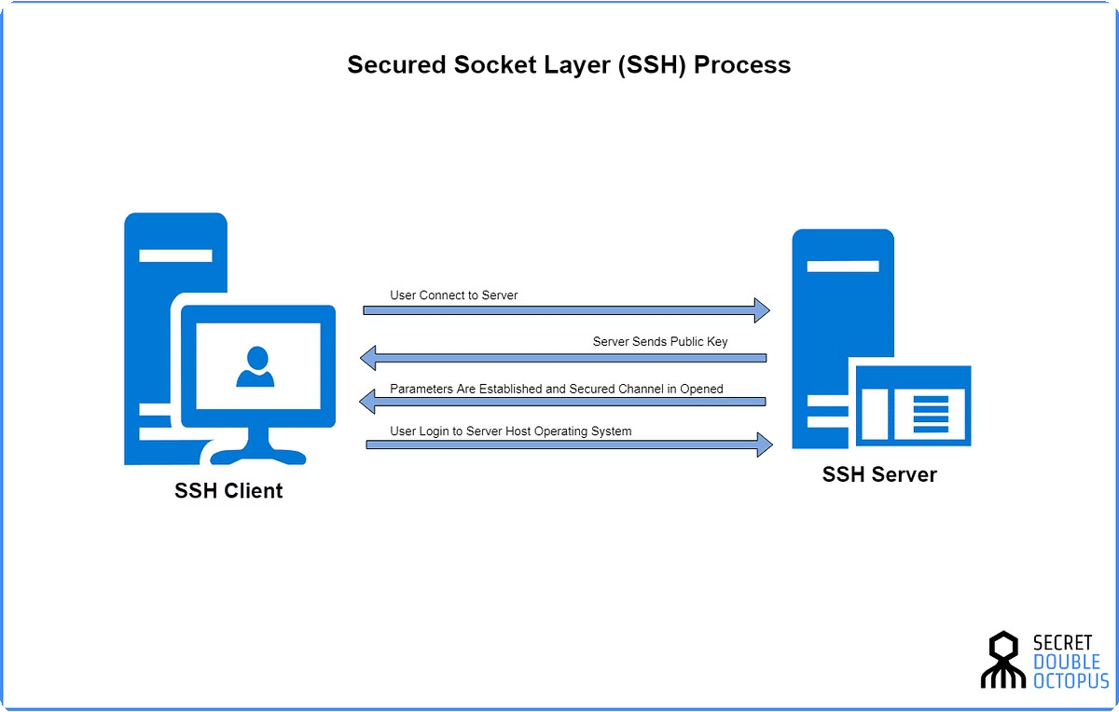
SSH
Secure Connection
SSH encrypts network traffic between devices, preventing eavesdropping and ensuring data confidentiality during transmission.
Remote Access
SSH enables secure remote access to network devices, allowing administrators to manage and configure devices from anywhere.

Slide 10

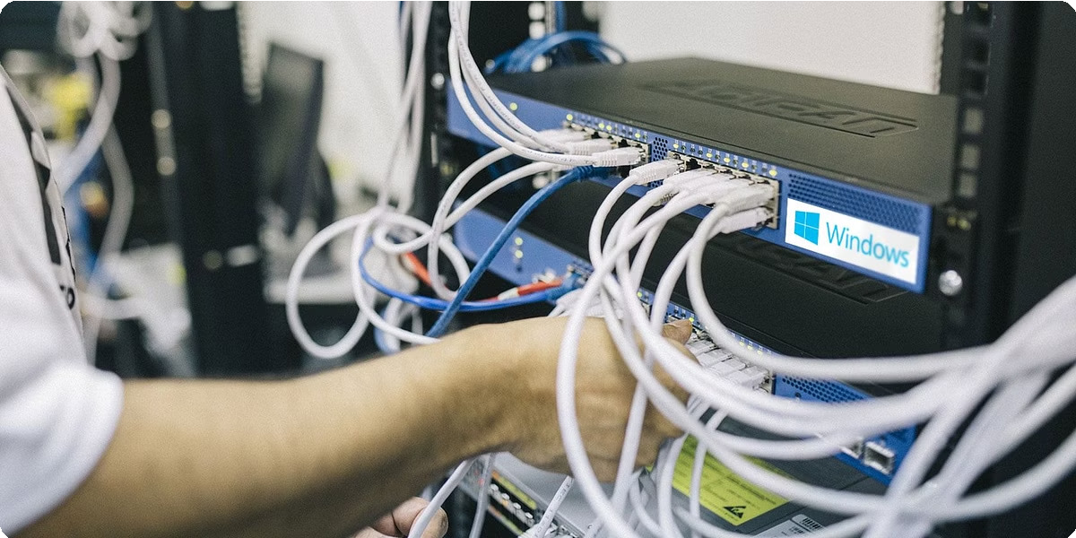
Troubleshooting Network Issues
1
Identify Symptoms
Understand the specific issue: connectivity loss, slow performance, or unusual behavior.
2
Gather Information
Collect relevant data: device configurations, logs, and network traffic analysis.
3
Isolate the Problem
Systematically narrow down the potential causes of the issue, examining each component in the network.
4
Implement Solutions
Apply appropriate fixes based on the identified cause, ensuring that changes are tested and validated.

